Slide 1
[Month] All - Team Meeting
Month, Day, Year | 3 – 4:30

Slide 2
Agenda
HR Updates
Welcome …
Interim positions for Sally’s Area
Search Updates
HR Hub Slack Channel: TLC HR team directly.
TLC HR Happenings Calendar
Wellness Wander
Fit Break
Gratitude Wall
Unit Strategic Plan
Website Updates
General Updates
Budget Process
Space Updates
Blue
SET/HET

Slide 3
HR Updates

Slide 4
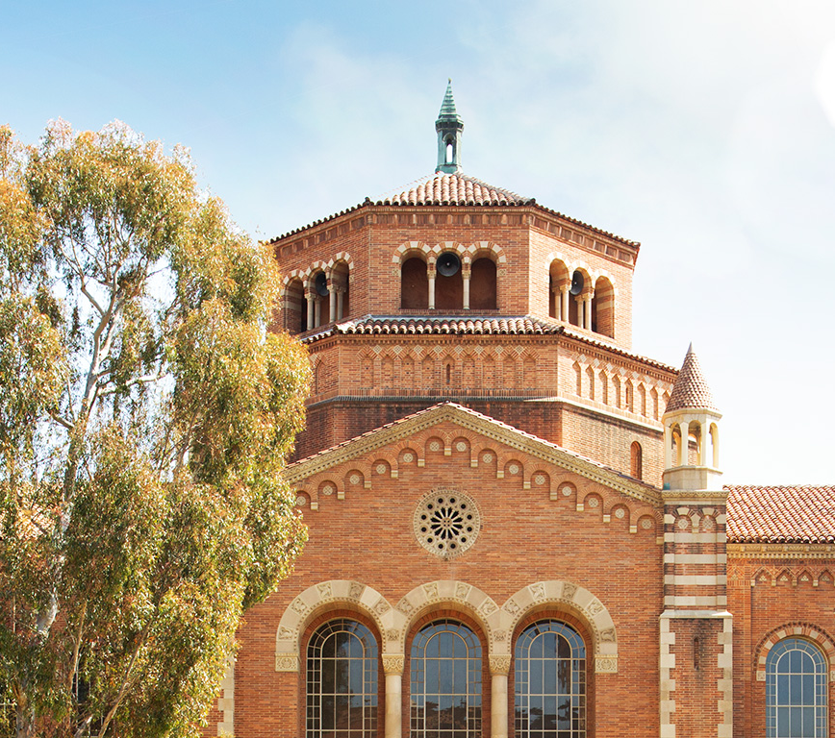
TLC Mission | Our Motivation & Current Aims
The mission of the TLC is to bring together a campus wide community of educators, support their well-being, equip them with the instructional skills and pedagogical knowledge to elevate their teaching, and further inspire an enduring commitment to student success. The TLC approaches this work by:
Engaging practitioners in inclusive, effective, and reflective teaching practices
Advancing innovative and engaging instructional approaches across disciplines in coordination with campus partners
Championing technology-enhanced, student-centered, and accessible curricular design
Leveraging the science of learning and institutional data informed by the identities and lived experiences of UCLA students and instructors
Promoting collaborative, pioneering educational initiatives and transformative, multidisciplinary pedagogical research

Slide 5
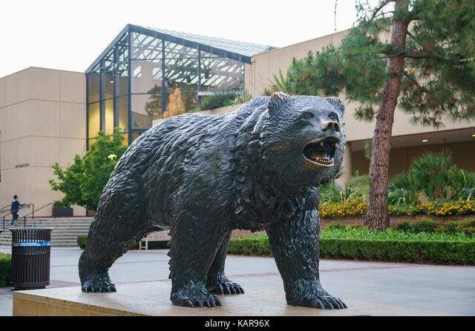
UCLA Teaching & Learning Center
ESSENTIAL FUNCTIONS
Teaching Resources
Professional Learning Programs
TA Training Program
Consultations on Teaching & Course Design
Instructional Innovation Grants
Instructional Design Support
Media Production Services
Assessment Support
Pedagogical Research Support
Special Projects (SET revision & expansion, HET)
SET and Exam Scoring Services

Slide 6
General Updates

Slide 7
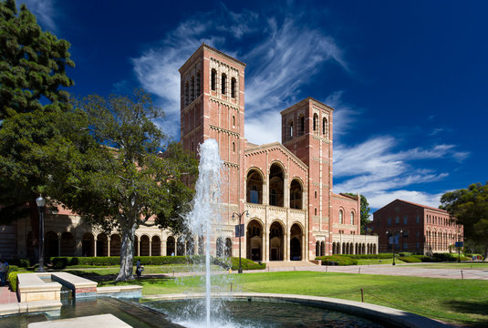
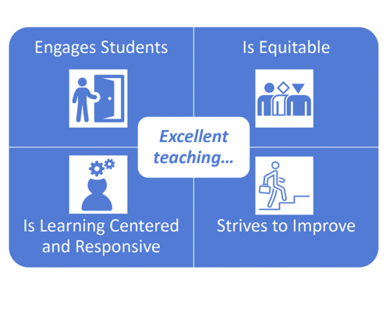
Additional Teaching Support Units at UCLA
School/Division-based Teaching Support
Center for Education Innovation and Learning in the Sciences (CEILS)
STEM teaching & learning center
Humanities Technology (HumTech)
Support for digital humanities projects improving instruction and research
Social Sciences Center for Education, Research, & Technology (SSCERT)
Computing, application development, and innovation services
UCLA Library
Study spaces, computer classrooms, instructional media**
Undergraduate Research Centers (Science and HASS)
Connect students to research opportunities
Center for Community Engagement (CCE)
Connect students to internship opportunities; collaborate with community partners

Slide 8
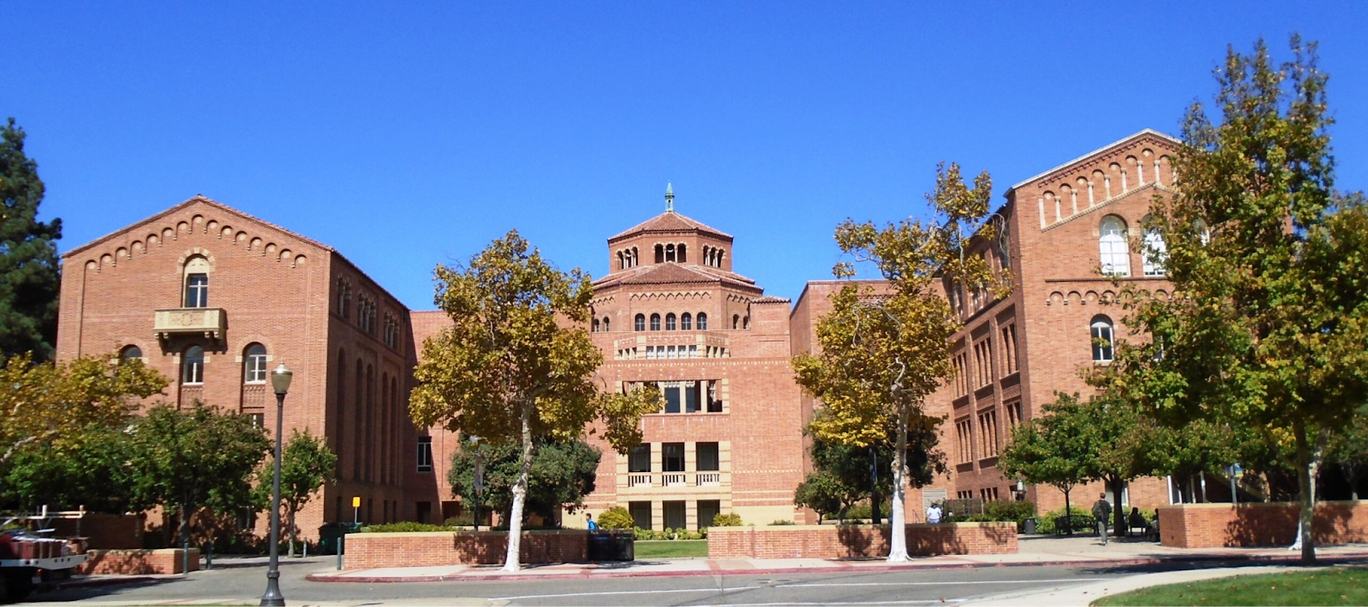
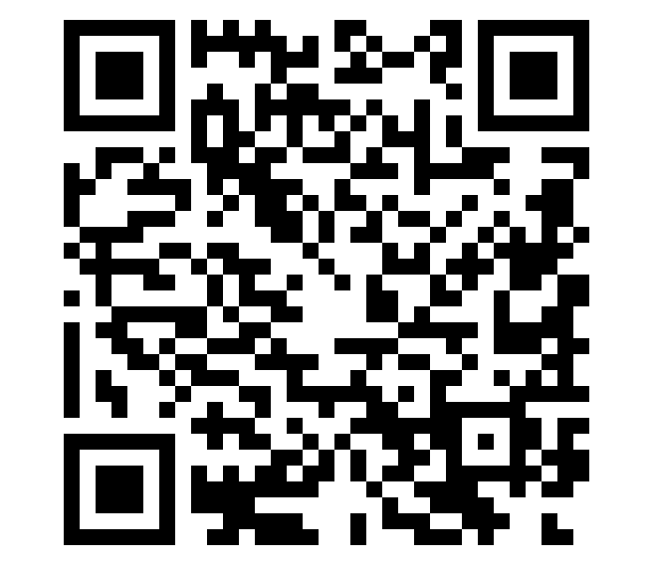
Connect with the TLC and Learn More
Come visit us in Powell Library
Visit our new website (launching 9/23)
Access through rear or east side entrances*
Say ‘hi’ to VPTL O’Leary in Suite 160!
https://teaching.ucla.edu/

Slide 9
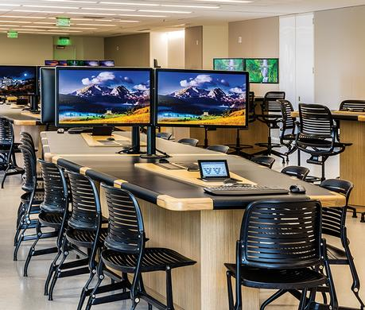
Teaching with Technology Resources & Services
Bruin Learn Center of Excellence (CoE)
For Canvas and other ed tech support:
email bruinlearn-support@it.ucla.edu or attend office hours
IT Services | Digital Spaces
For classroom AV, Streaming, and BruinCast support:
call x7HELP
open a ticket through the IT portal (https://it.ucla.edu/)
email help@it.ucla.edu
For classroom database search:
go to website (https://it.ucla.edu/classroom-search)

Slide 10
Thank You
Please Reach Out With Any Questions Or Concerns

